Slide 1
HIFI Stereo system
Team Hi-Potential
Section 8, Team 3

Slide 2
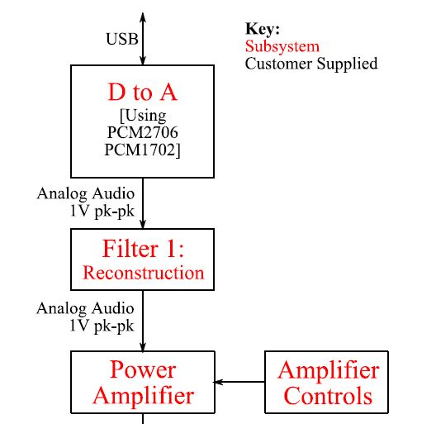
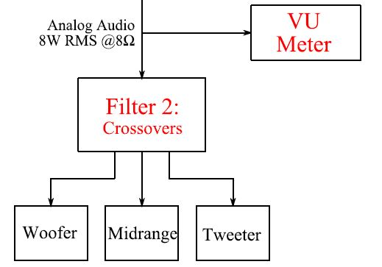
Whole-System Block Diagram
ECE 40200 Course Handout
Purdue West Lafayette, IN 47907

Slide 3
Final Acceptance Test
1. Be able to connect your system using a USB cable to a PC running windows
2. Play music on the PC out of the speaker system
3. Control the volume, treble, midrange and bass using a touchscreen GUI
4. Be impressed by the VU meter spectral reproduction
5. Be provided with a calibration certificate with the following:
1.The THD+N of the overall system (0dB @ 1kHz)
2.The THD+N after the reconstruction filter (0dB @ 1kHz) before the amplifier
3.An assessment of how to improve audio quality

Slide 4
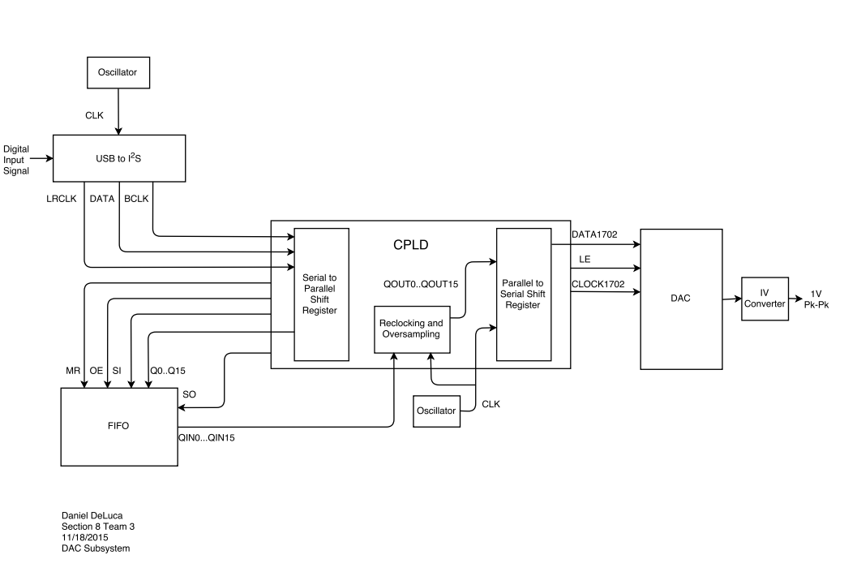
DAC Block Diagram

Slide 5
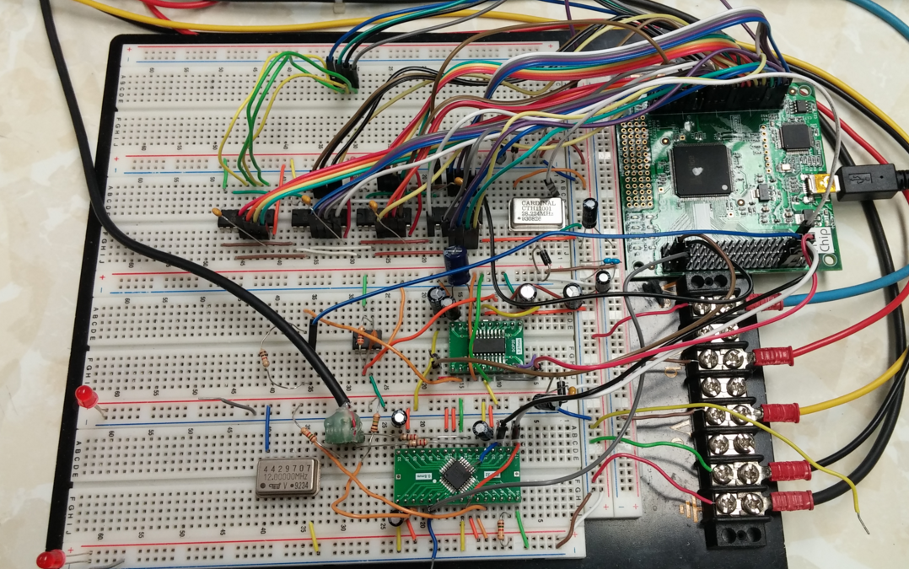
Prototype of DAC Subsystem
Four FIFO Chips for Clock Matching
ispMACHZE4256 CPLD
PCM2706 and PCM1702
Two Crystal Oscillators

Slide 6
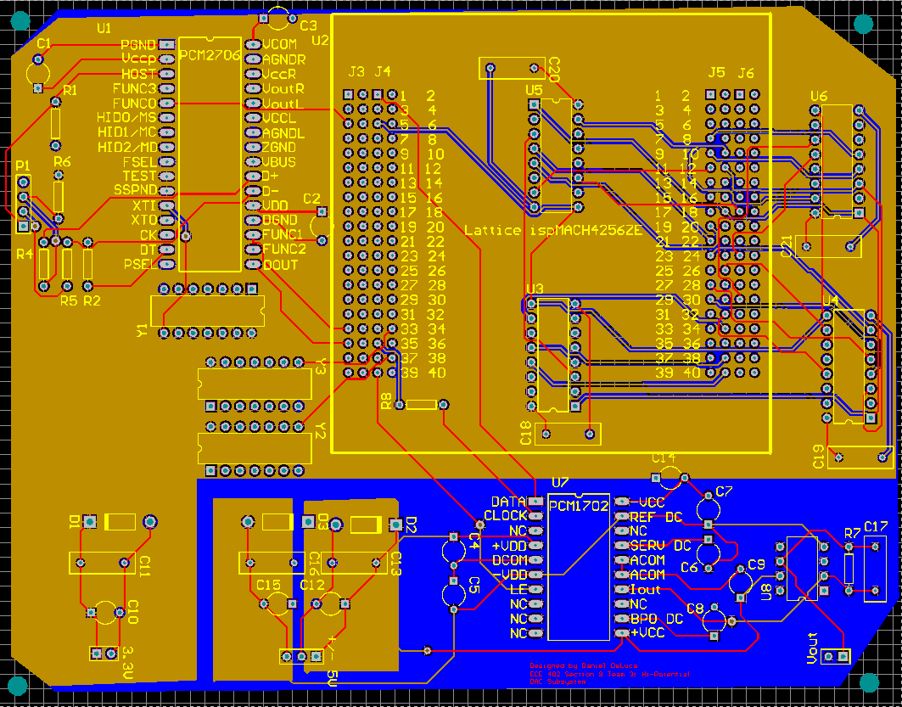
DAC Printed Circuit Board
Three Layer Board
Four Polygon Pours: GND, +/- 5V, 3.3V
Approximately 6” x 5”

Slide 7
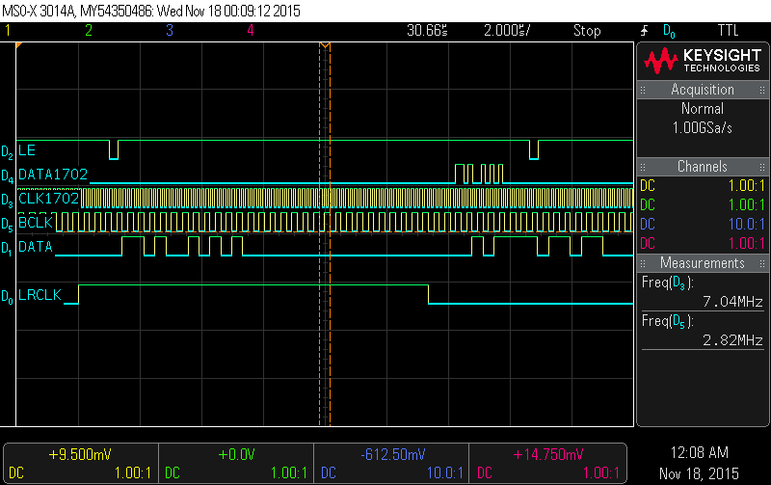
Data Transmission to PCM1702
Original Clock = 2.82MHz
New Clock = 7.056MHz
Reclocked Data Matches Original
LE Pulses for Decimation

Slide 8
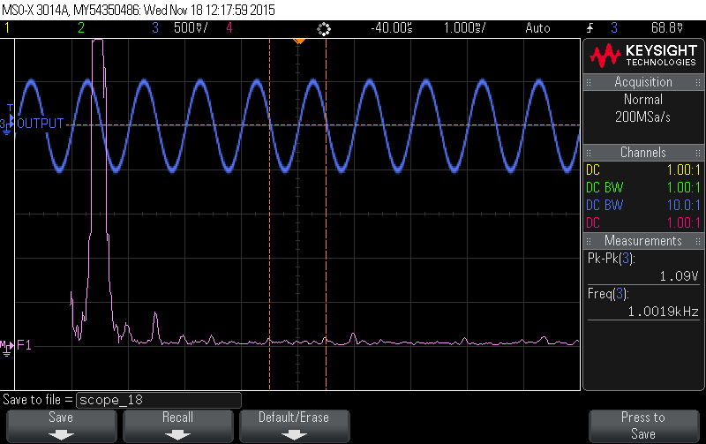
1 KHz Sine Wave from PCM1702
After I-V Conversion through Op Amp
Low 2nd, 3rd, 4th Harmonics
Output 1 Vpk-pk
Reclocked to 7.056MHz

Slide 9
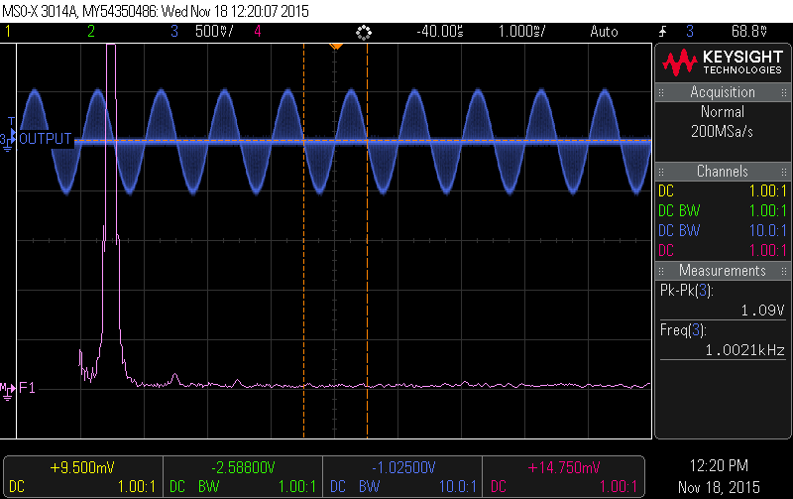
Decimated 1 KHz Sine Wave
Output 1 Vpk-pk
Lower 2nd, 3rd, 4th Harmonics
More Integration Testing Needed
Reclocked to 7.056 MHz

Slide 10
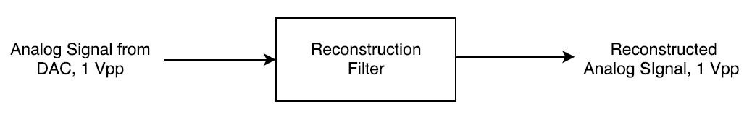
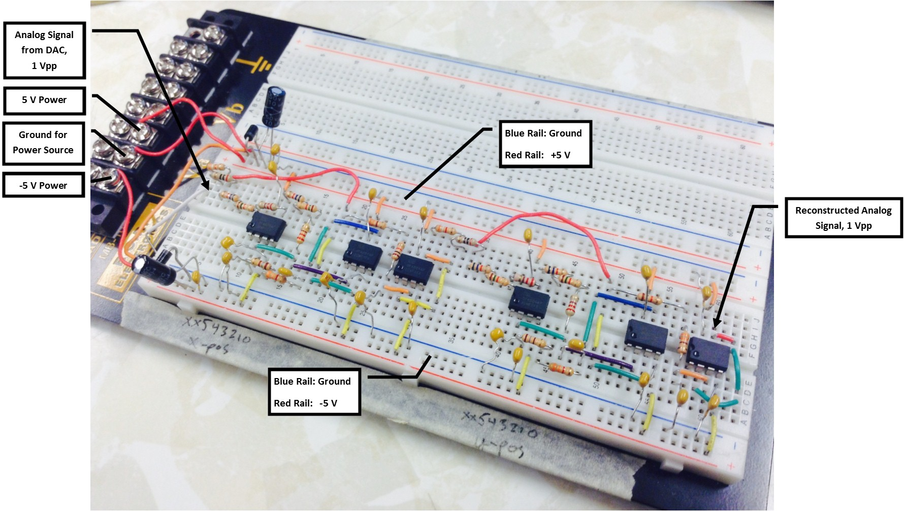
Reconstruction Filter

Slide 11
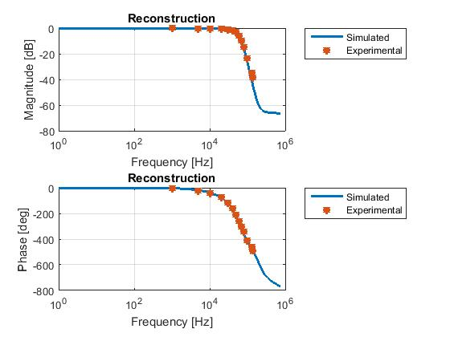
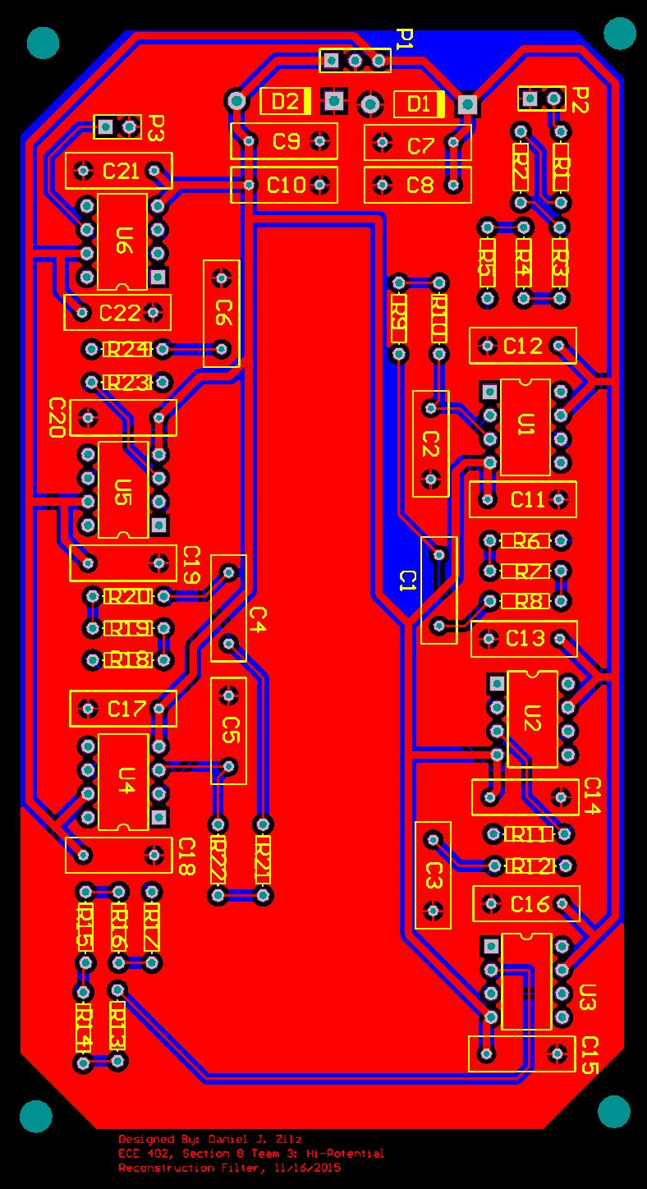
Reconstruction Filter
Printed Circuit Board
- Two Layer
- Two Ground Planes
- 32 mil power traces

Slide 12
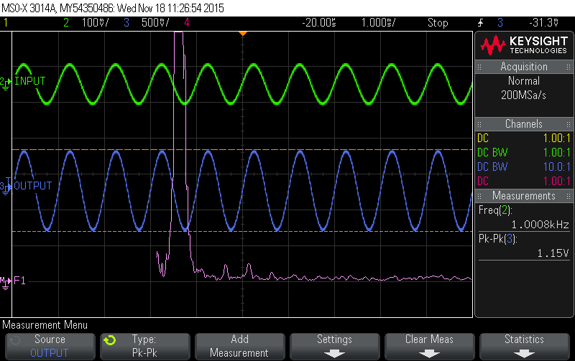
Reconstruction Filter: Harmonic Distortion
Tested with a 1kHz sinewave @ -15dB, no oversampling
-THD: 0.2354% or -52.56dB

Slide 13
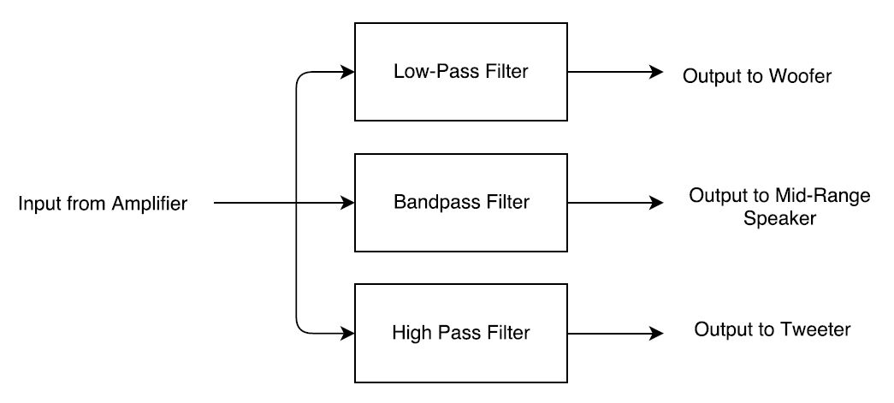
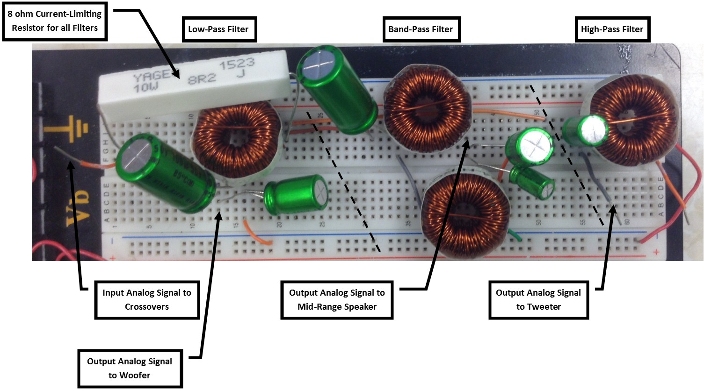
Crossover Filter

Slide 14
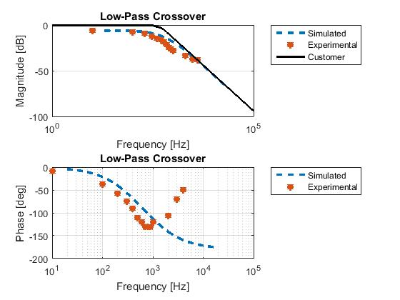
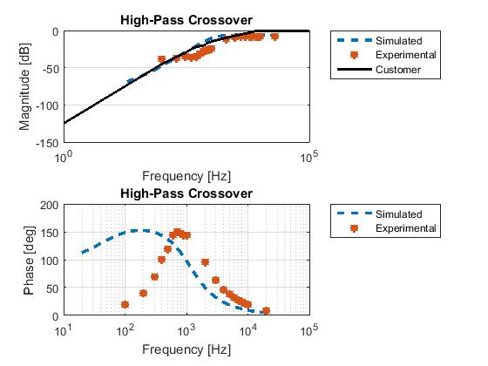
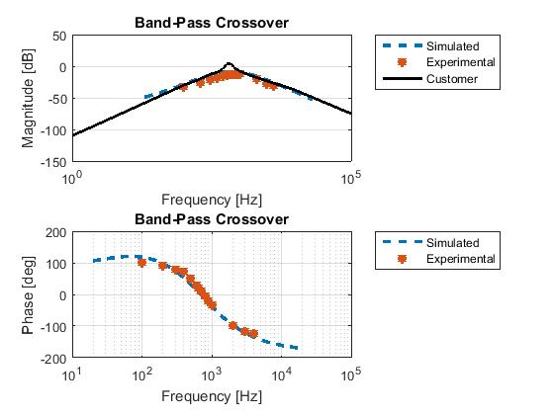
Crossover Filters

Slide 15
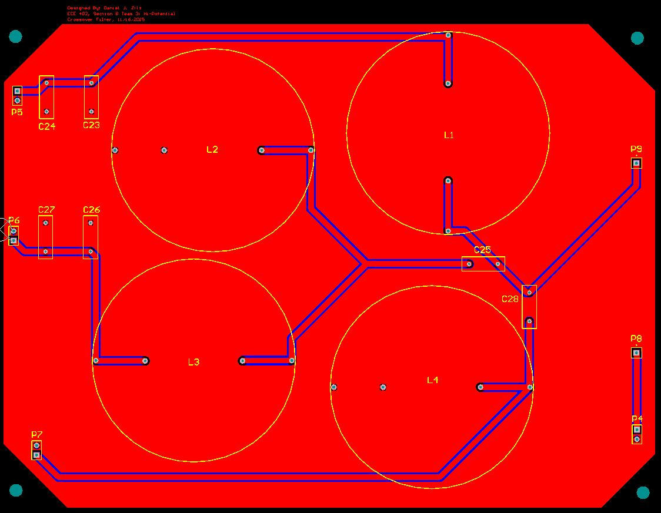
Crossover Filters
Printed Circuit Board
- Two Layer
- Two Ground Planes
- 60 mil traces

Slide 16
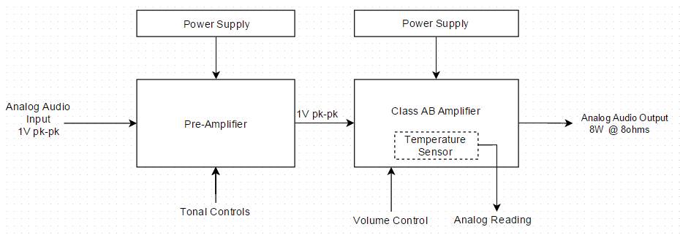
Power Amplifier
Min. 8W RMS at 8Ω Speakers
Max. 1% 2nd harmonic distortion
Max. 0.2% 3rd harmonic distortion

Slide 17
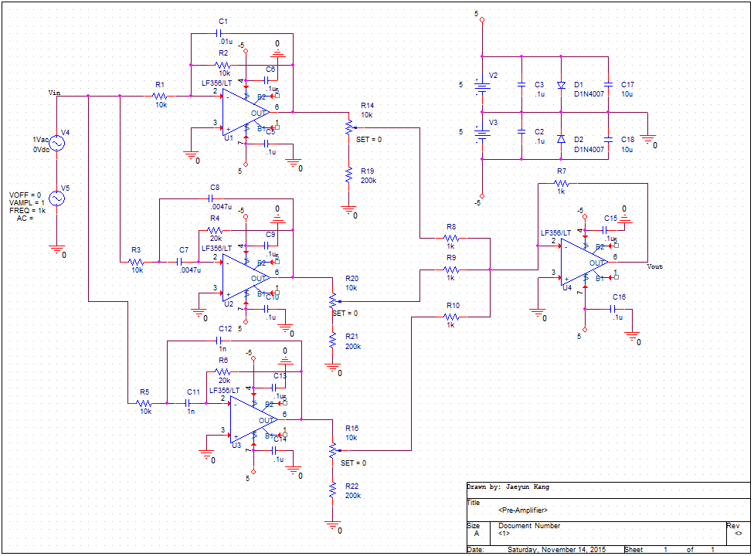
Pre-Amplifier (Tone Control)

Slide 18
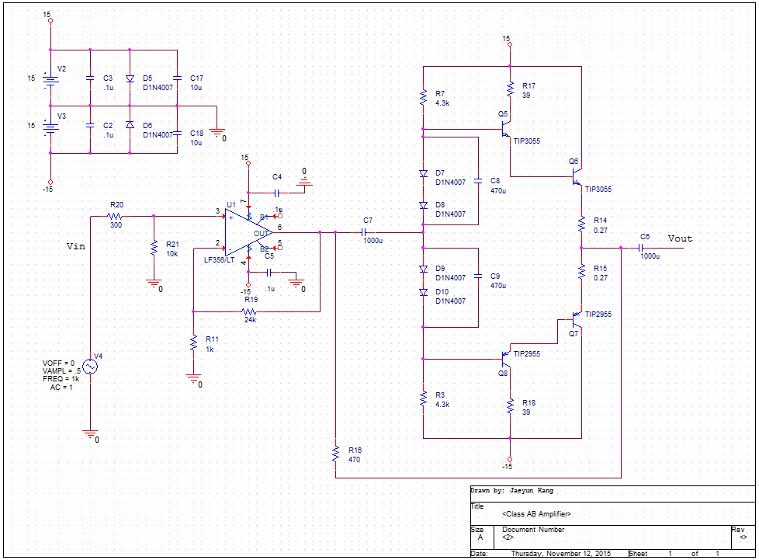
Class AB Amplifier

Slide 19
Result of Pre-amplifier

Slide 20
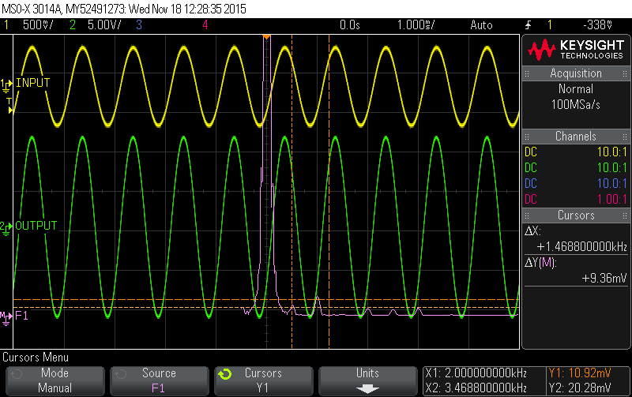
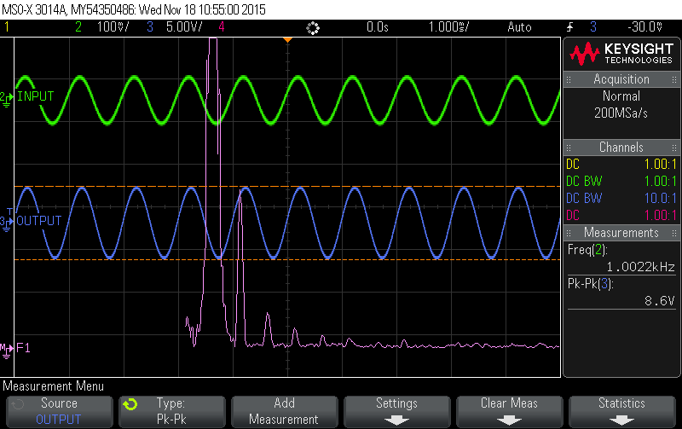
Result of Class AB Amplifier
Output of power amplifier
Power = 8.48 W RMS
2nd HD = 0.0937%
3rd HD = 0.174%
Integration of the whole system
THD+N = 0.452% = -46.89dB

Slide 21
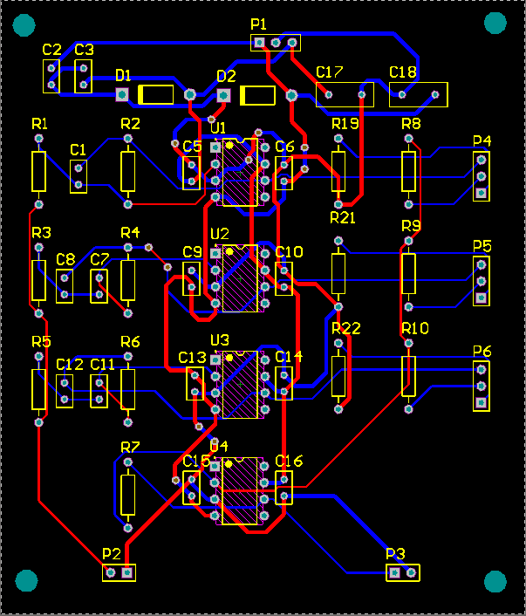
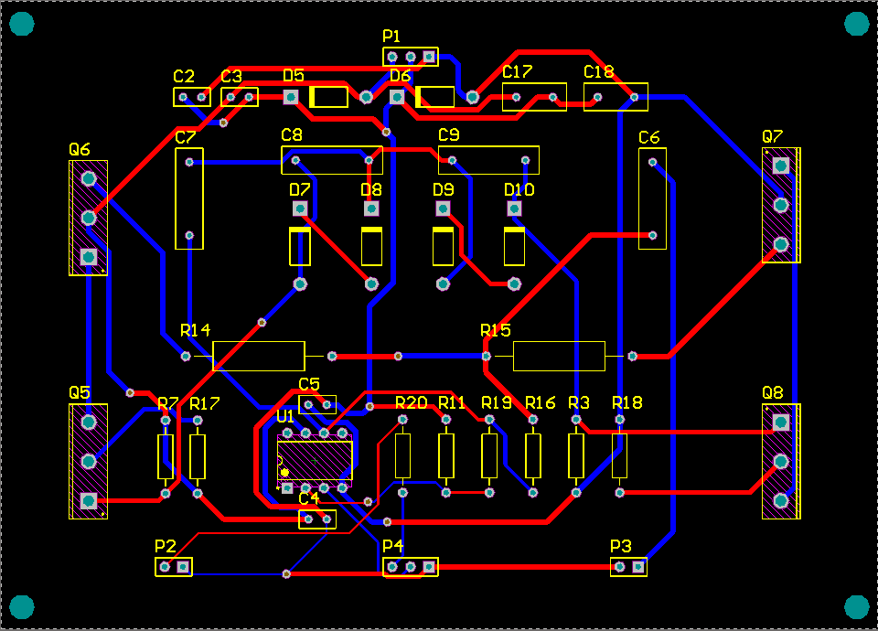
PCBs for Power Amplifier
Class AB amplifier
Pre-amplifier

Slide 22
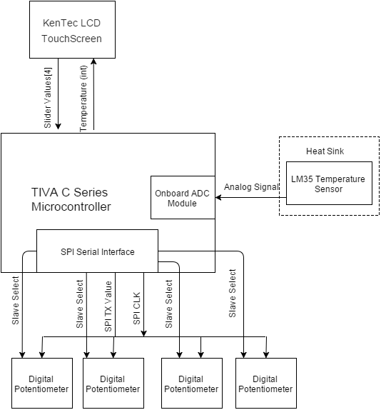
Amplifier Control Subsystem
Detailed Block Diagram

Slide 23
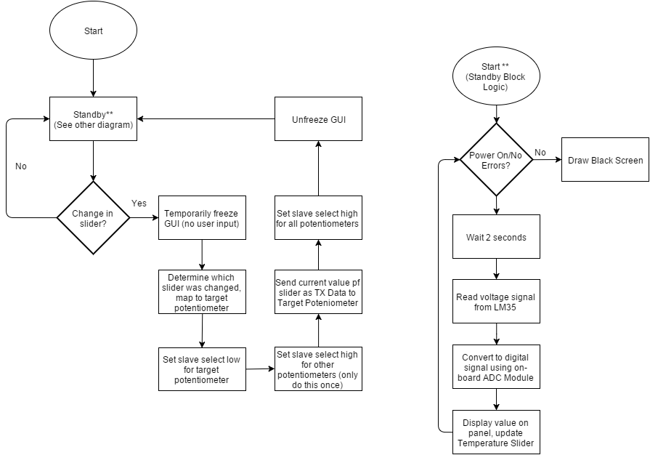
Amplifier Control Flow Chart

Slide 24
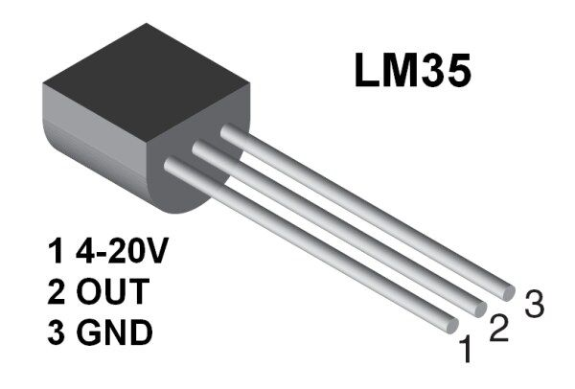
LM35 Temperature Sensor

Slide 25
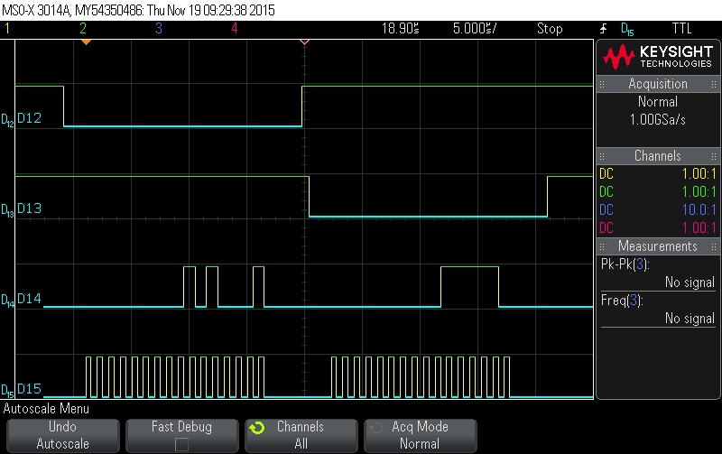
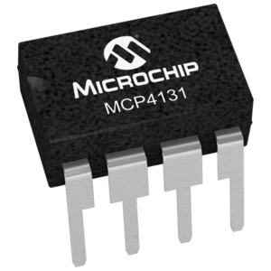
Digital Potentiometers
Potentiometer Step Value | Expected Resistance | Measured Resistance
0/128 | 0 KΩ | ~0 KΩ
32/128 | 2.5 KΩ | 2.5 KΩ
64/128 | 5 KΩ | 4.97 KΩ
96/128 | 7.5 KΩ | 7.45 KΩ
128/128 | 10 KΩ | 9.89 KΩ

Slide 26
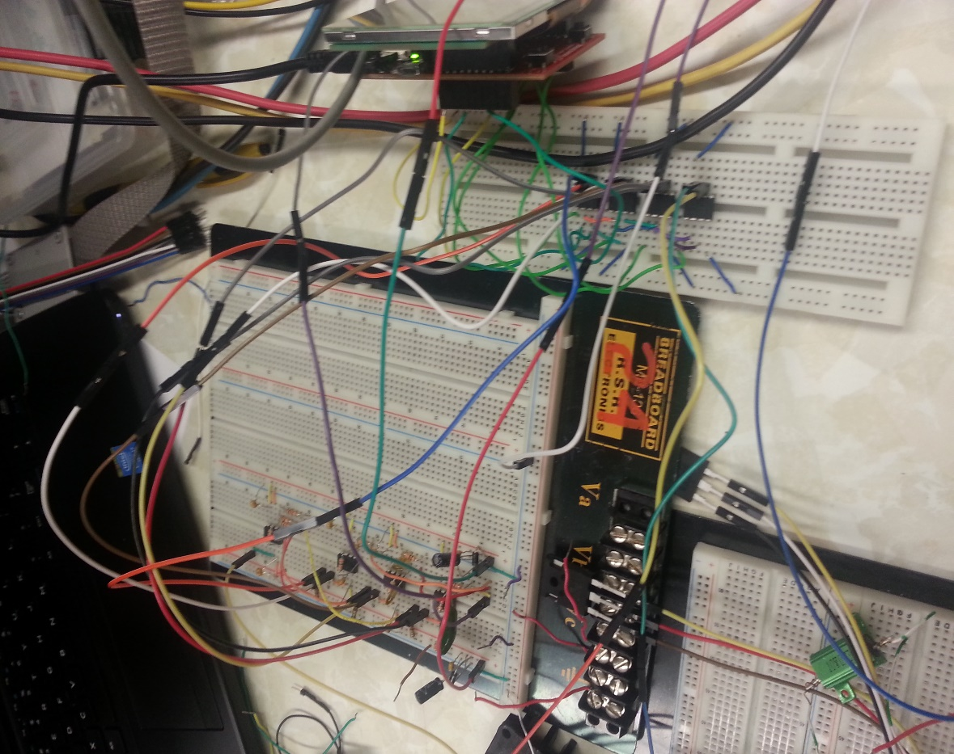
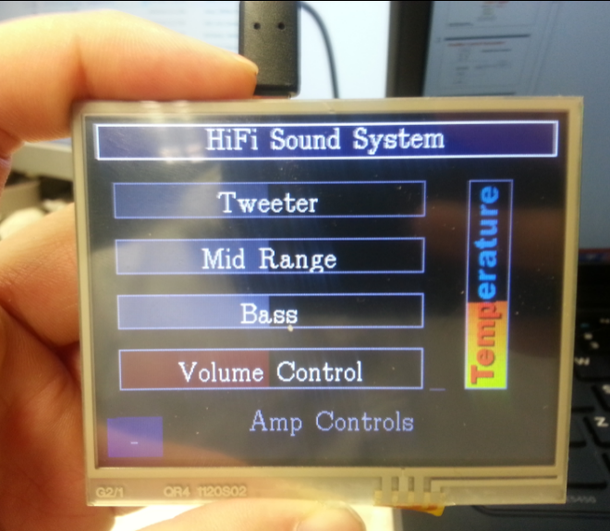

Slide 27
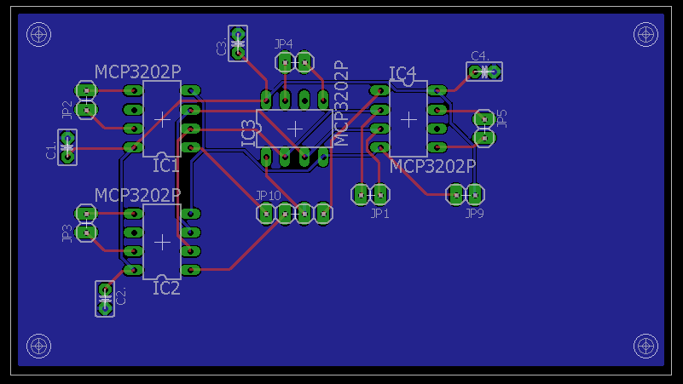
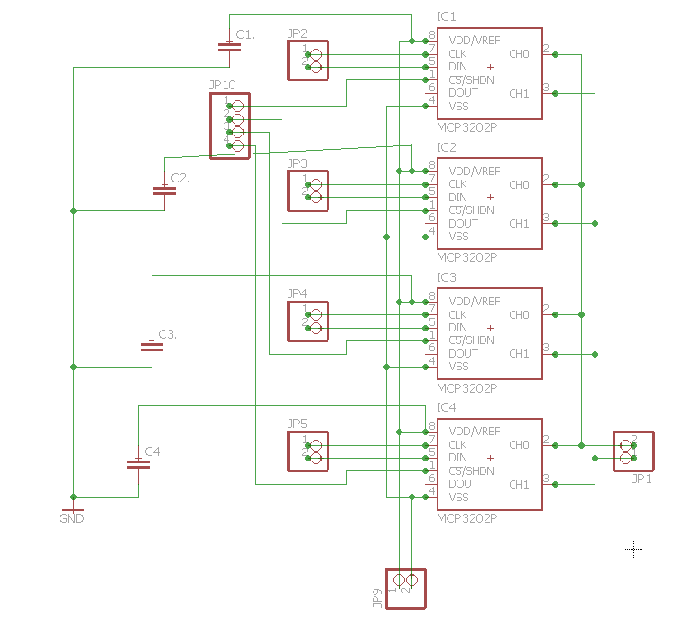
Schematic and PCB Design

Slide 28
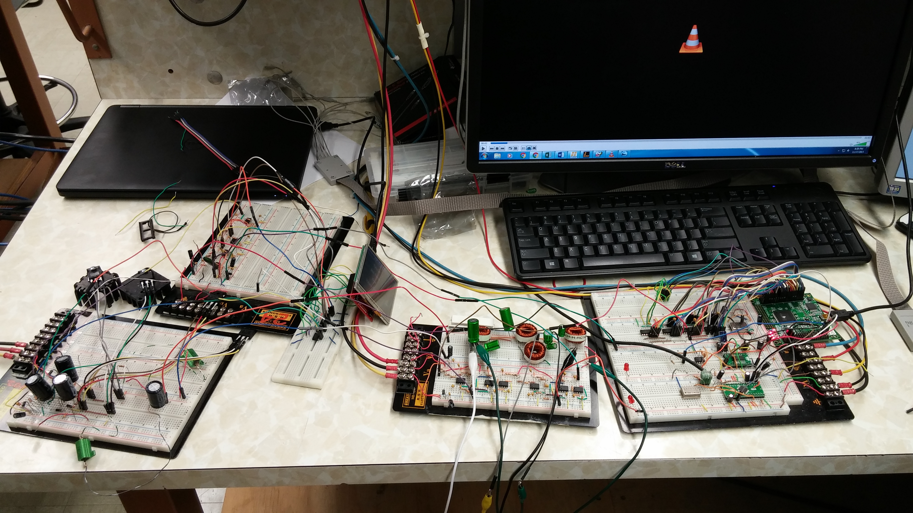

Slide 29
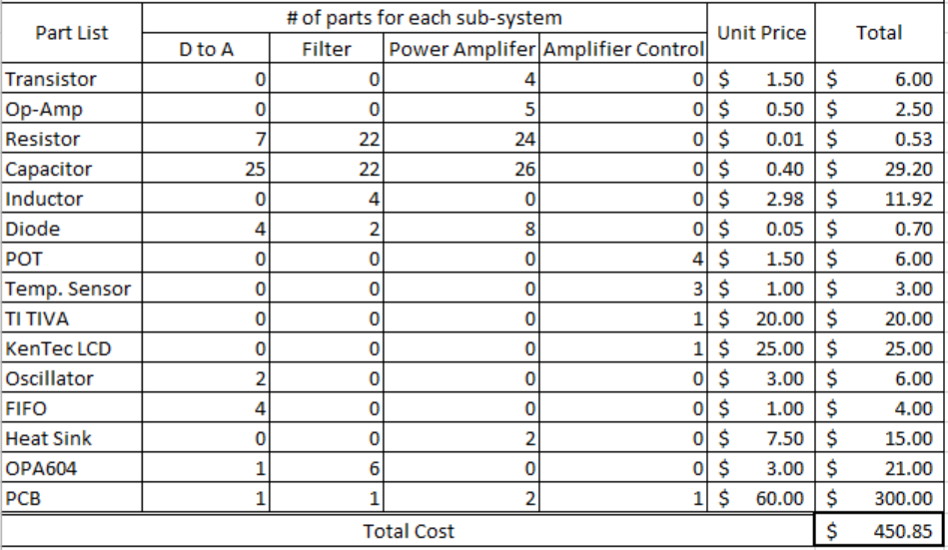
Subsystem Considerations:
DAC – Linear Interpolation will improve audio quality
Tonal Controls – Small adjustments, possibly added resistance on volume control
Overall – All subsystems and integration are on track, PCBs all ordered

